Slide 1

Sector 29, Pradhikaran, Akurdi, Pune – Maharashtra, INDIA 411044
(Establishment by Maharashtra Act No. LXIII of 2017)
School of Computer Science, Engineering & Applications
INDUSTRIAL INTERNSHIP ON
Corporate Web Development & Machine Learning based
Energy Demand Prediction
StartBrett Private Limited · Industrial Automation · Pune, Maharashtra
PRESENTED BY
RESEARCH INTERNSHIP IN-CHARGE (DIVISION WISE)
Pranav Ashok Pande
Dr. Dipika Pradhan
PRN 20240802208 · B.Tech. Computer Science and Engineering (AI–ML)
Dr. Rohini Tarade · Industry Mentor: Mr. Sachin Bindge
Academic Year 2025 – 26
31/07/2026
01
Notes:
Good morning. This presentation covers my industry internship at StartBrett Private Limited, Pune — a responsive corporate website and a machine-learning based energy demand prediction system.

Slide 2








PRESENTATION ROAD MAP
Contents
Structure of this internship presentation
01
02
03
04
Introduction
Literature Survey
Proposed Methodology
Analysis and Design
Context, objectives and problem statement
Existing systems, drawbacks and gaps
Workflow, ML pipeline and tools
ER, class/object and flow diagrams
05
06
07
08
Result and Discussions
Geo-tagged Field Photos
Conclusions
References
Website outcome and RMSE evaluation
On-site documentation of the internship
Outcomes, learning and future work
Research papers and sources consulted
31/07/2026
02
Notes:
The deck follows the structure of the internship report: introduction, objectives, literature survey, methodology, design, results and conclusion.

Slide 3




01 · INTRODUCTION
Introduction
Bridging classroom theory and industrial practice
An internship is the bridge between academic study and professional engineering practice. It converts classroom concepts into working systems and exposes a student to real deadlines, real users and real constraints.
Web Development
Responsive, SEO-optimised corporate website built with HTML5, CSS3 and JavaScript
During this internship at StartBrett Private Limited I worked across two complementary domains — front-end web engineering and applied machine learning — following the complete software development life cycle from requirement gathering to testing and deployment.
Machine Learning
Energy demand prediction using interpretable Linear & Polynomial regression models
Key takeaway
Industrial exposure builds not only technical skill, but documentation discipline, teamwork and time management.
Professional Practice
Version control, documentation, code review, testing and team communication
31/07/2026
03
Notes:
The internship combined web engineering with applied machine learning, and gave exposure to professional software practices.

Slide 4






01 · INTRODUCTION
The Host Organisation
StartBrett Private Limited — industrial automation engineering, Pune
PROJECT 01
Corporate Website
StartBrett Private Limited
A responsive, accessible and search-optimised digital storefront that presents the company's automation services and captures customer enquiries.
An industrial automation company delivering PLC programming, SCADA systems, control-panel manufacturing and instrumentation for turnkey projects across India.
HTML5 · CSS3 · JavaScript
Responsive across all devices
SEO & performance tuned
Chakan Industrial Area, Pune
PROJECT 02
PLC · SCADA · Instrumentation
Energy Demand Prediction
An interpretable machine-learning framework that forecasts electricity demand from historical consumption and weather data.
Mentor: Mr. Sachin Bindge
Linear & Polynomial regression
Python · Scikit-learn · Pandas
Evaluated using RMSE
31/07/2026
04
Notes:
StartBrett is an industrial automation firm in Pune. Two deliverables were assigned: the corporate website and the energy demand prediction system.

Slide 5




01 · INTRODUCTION
Objectives of the Internship
Fifteen report objectives distilled into six measurable goals
Gain industrial exposure
Build a production website
Apply the full SDLC
Understand professional workflow, organisational structure and industry standards
Design and implement a responsive, interactive and SEO-friendly corporate platform
Requirement gathering, design, development, testing, deployment and maintenance
Practise applied ML
Strengthen data skills
Develop professional skills
Implement interpretable predictive models for real energy-demand forecasting
Collect, clean, preprocess and analyse time-series and weather datasets
Teamwork, communication, documentation discipline and time management
31/07/2026
05
Notes:
These six goals summarise the fifteen objectives listed in the report: industrial exposure, web delivery, SDLC understanding, applied ML, data skills and professional development.

Slide 6


01 · INTRODUCTION
Problem Statement
Two distinct problems were identified during the internship
PROBLEM 01
PROBLEM 02
Weak digital presence
Unreliable demand forecasting
No responsive, modern platform to present automation services
Static content with poor navigation and slow load performance
Limited search visibility, so prospective clients cannot find the firm
No structured channel for capturing customer enquiries
Energy consumption fluctuates with weather, season and consumer behaviour
Traditional statistical baselines cannot model non-linear demand patterns
Deep-learning models are accurate but opaque and computationally heavy
Industry needs forecasts that are both accurate and explainable
Goal: deliver one modern, responsive web platform and one accurate yet interpretable forecasting model — both validated against measurable criteria.
31/07/2026
06
Notes:
Problem one concerns digital presence; problem two concerns accurate but explainable demand forecasting.

Slide 7





02 · LITERATURE SURVEY
Literature Survey
Evolution of energy demand forecasting methods
Statistical models
Classical ML
Deep learning
Interpretable ML
ARIMA, moving average, exponential smoothing
SVM, decision trees, random forests
RNN, LSTM, CNN predictors
Linear & polynomial regression (LR / NLR)
Simple, but assume linear relationships
Learns non-linear patterns from features
High accuracy — but black-box and data hungry
Accurate, transparent and cheap to deploy
Reference framework: Kamoona et al. (2023), “Machine learning based energy demand prediction”, Energy Reports 9, 171–176 — combines temperature with historical consumption using simple, interpretable LR and NLR predictors.
31/07/2026
07
Notes:
Forecasting has moved from statistical models to deep learning. The reference paper argues that for industry, interpretable models are often preferable.

Slide 8

02 · LITERATURE SURVEY
Drawbacks of Existing Systems
Where current web platforms and forecasting systems fall short
Existing corporate web platforms | Existing demand forecasting systems
Largely static information with no interactive or intelligent features | Linear statistical models cannot capture non-linear consumption behaviour
Incomplete responsiveness — poor experience on tablets and phones | Deep-learning predictors need large datasets and heavy computation
Unoptimised assets cause slow page loads and higher bounce rates | Black-box behaviour makes results hard to explain to decision makers
Weak SEO implementation limits organic reach and visibility | Sensitive to missing, noisy or inconsistently collected data
Continuous maintenance needed for security and browser compatibility | Poor generalisation — frequent retraining for new regions or sites
Consequence: the business needs a platform that is responsive, fast and discoverable — and a forecasting model that is accurate without becoming a black box.
31/07/2026
08
Notes:
Two parallel sets of limitations motivated the internship work.

Slide 9




02 · LITERATURE SURVEY
Gaps Identified — SWOT of the Proposed Approach
Strategic assessment of the solution adopted during the internship
S
Strengths
W
Weaknesses
Interpretable models — no black-box behaviour
Low compute cost, quick to retrain and deploy
Responsive, SEO-ready website on standard web stack
Accuracy depends on clean, complete historical data
Regression models cannot capture very long-range dependencies
Website needs continuous content and security maintenance
O
Opportunities
T
Threats
Extend features with humidity, pressure and solar radiation
Integrate live analytics and enquiry intelligence into the site
Apply the same framework to any time-series prediction problem
Shifting consumption patterns degrade model accuracy over time
Cyber-security exposure and browser compatibility drift
Competition for search ranking and online visibility
31/07/2026
09
Notes:
The SWOT frames why interpretable regression was chosen and what risks remain.

Slide 10




03 · PROPOSED METHODOLOGY
Proposed Methodology
A single systematic workflow applied to both deliverables
Requirement Analysis
Design & Architecture
Development
Testing & Evaluation
Deployment & Review
Scope, users, functional needs
Layouts, data model, pipeline
Build, iterate, version control
Responsiveness, RMSE scoring
Publish, document, maintain
Track A — Corporate website
Track B — Energy demand prediction
Built with HTML5, CSS3 and JavaScript. Semantic markup, mobile-first responsive layouts, optimised assets and structured metadata for search visibility. Verified across desktop, tablet and mobile viewports.
Historical consumption concatenated with ambient temperature, split into time windows (TW) to form (X, Y) batches, then trained with Linear and Polynomial regression and scored using RMSE on held-out data.
31/07/2026
10
Notes:
Both projects followed the same five-stage methodology, with track-specific implementation detail.

Slide 11
03 · PROPOSED METHODOLOGY
The Machine Learning Pipeline
From raw meter readings to an evaluated forecast
01
Data concatenation
LINEAR REGRESSION (LR)
Historical energy demand joined with ambient temperature
ŷ = a₁x₁ + a₂x₂ + … + b
Approximates the relation between load and temperature in a linear fashion.
02
Pre-processing
Cleaning, normalisation and time-window (TW) batching into (X, Y)
NON-LINEAR REGRESSION (NLR)
Feature selection
ŷ = a₁x₁² + a₂x₂² + … + b₁x₁ + … + c
03
Demand · temperature · precipitation · solar radiation
A second-order polynomial that follows the load–temperature relation more closely.
04
Model training
Linear Regression (LR) and Polynomial Non-Linear Regression (NLR)
EVALUATION METRIC
RMSE = √ ( Σ (y − ŷ)² / n )
05
Forecast & evaluation
Root mean square error — a smaller value indicates a better forecast.
Predicted demand scored against actual load using RMSE
31/07/2026
11
Notes:
The pipeline mirrors the framework of Kamoona et al.: concatenate, window, train, forecast, evaluate with RMSE.

Slide 12






03 · PROPOSED METHODOLOGY
Tools & Technologies
The stack used across both deliverables
HTML5
CSS3
JavaScript
VS Code
Semantic page structure
Responsive layout & styling
Interactivity & behaviour
Primary development editor
Python
Pandas · NumPy
Scikit-learn
Git · Chrome DevTools
ML implementation language
Preprocessing & computation
LR and polynomial models
Version control & debugging
31/07/2026
12
Notes:
A deliberately lightweight, industry-standard stack: vanilla web technologies for the site and the Python data-science stack for the model.

Slide 13



04 · ANALYSIS AND DESIGN
Analysis and Design
The system was modelled before a single line of code was written
ER Diagram
Class & Object Diagram
Data Flow Diagram
Entity relationships across both subsystems
Static structure of the two modules
Level 0 context and Level 1 decomposition
Company · Website · User · Enquiry
Historical Data · ML Model · Prediction
One-to-many links carry primary and foreign keys
Website module: Company, Website, User, Enquiry
ML module: HistoricalData, Preprocessing, MLModel, Prediction
Methods such as trainModel(), evaluateModel(), predict()
Level 0: website system and prediction system as processes
Level 1: collect → preprocess → train → predict
Data stores for raw, processed, model and prediction data
31/07/2026
13
Notes:
Three UML/database artefacts were produced: the ER diagram, the class and object diagram, and level 0/1 data flow diagrams.

Slide 14


04 · ANALYSIS AND DESIGN
Flow Diagram
Level 1 data flow decomposition of both subsystems
1.0 Corporate Website System
PROCESS 1.1
PROCESS 1.2
PROCESS 1.3
PROCESS 1.4
DATA STORE
View pages
Browse services
Submit enquiry
Manage enquiries
D1 Enquiry data
Home & services
PLC · SCADA · panels
Validated form data
Admin review
Stored records
2.0 Energy Demand Prediction System
PROCESS 2.1
PROCESS 2.2
PROCESS 2.3
PROCESS 2.4
DATA STORE
Collect data
Preprocess data
Train model
Predict demand
D2 Prediction data
Demand + weather
Clean & window (TW)
LR / NLR fitting
Forecast horizon
Results & RMSE
Level 0 context: external entities (website user, company admin, data source, end-user analyst) exchange data with the two systems; Level 1 above decomposes each into its sub-processes and data stores.
31/07/2026
14
Notes:
The flow diagram shows the level 1 decomposition: the website path from page view to enquiry storage, and the prediction path from data collection to stored forecasts.

Slide 15



05 · RESULT AND DISCUSSIONS
The Corporate Website
A responsive digital platform for an industrial automation business
Fully responsive across desktop, tablet and mobile
www.startbrett.com
Clear service architecture — PLC, SCADA, panels, instrumentation
ENGINEERING SMART INDUSTRIAL
Structured metadata and semantic markup for search visibility
Automation Solutions
PLC programming · SCADA systems · control panels · instrumentation — delivered as turnkey projects across India.
Optimised assets giving fast first paint and smooth navigation
Get a quote
Enquiry capture flow connecting visitors to the sales team
Cross-browser verified using Chrome developer tools
PLC
Panels
SCADA
Sensors
3
100%
1
Breakpoints
Responsive
Codebase
31/07/2026
15
Notes:
The delivered site is responsive, SEO-ready and presents the company's four service lines with a clear enquiry path.

Slide 16



05 · RESULT AND DISCUSSIONS
Forecasting Accuracy — RMSE Comparison
Overall RMSE % on Dataset 1 (six C&I customer portfolios) — lower is better
84% lower error
NLR with temperature cuts overall RMSE from 17.88% to 2.87%
Fully interpretable
Coefficients can be read and explained — no black-box behaviour
Temperature helps
Adding maximum daily temperature improves the polynomial model
31/07/2026
16
Notes:
Both ML predictors beat the market baseline by a wide margin; the polynomial model with temperature is the best performer at 2.87% RMSE.

Slide 17
KEY FINDING
84%
17.88%
3.67%
Baseline RMSE
Linear regression
Current industry baseline
Simple linear predictor
reduction in forecasting error
The polynomial regression predictor with ambient temperature reduced overall RMSE from the market baseline of 17.88% to 2.87% — while remaining simple enough for an engineer to read, explain and audit.
2.87%
6
Polynomial + temp
C&I portfolios
Best performing model
Chemical, telecom, water, university
Source: overall RMSE comparison, Dataset 1 — Kamoona et al., Energy Reports 9 (2023) 171–176
17
Notes:
The headline result: an 84 percent reduction in error against the baseline, achieved with a model that remains fully interpretable.

Slide 18
05 · RESULT AND DISCUSSIONS
Model 1 vs Model 2 — Dataset 2
Does the framing of the input window change forecast quality?
Model 1
Model 2
Same historical time stamps
Preceding time stamps (TW)
Uses the same time stamp on previous days (e.g. yesterday's 10:00 to predict today's 10:00), optionally adding exogenous factors.
Uses the readings immediately before the target (07:00–09:30 to predict 10:00), respecting the continuity of the series.
Mirrors the conventional baseline method
Ignores continuity between adjacent readings
Higher RMSE across every window setting
Captures short-term dependency in the series
Best result: NLR-DemandTemp at TW = 10
Consistently outperforms Model 1
Demand
DemandTemp
DemandTempOthers
Historical consumption only
Consumption + ambient temperature
+ precipitation & solar radiation
31/07/2026
18
Notes:
Model 2, which respects the continuity of the time series, outperformed Model 1 across every time-window setting and scenario.

Slide 19

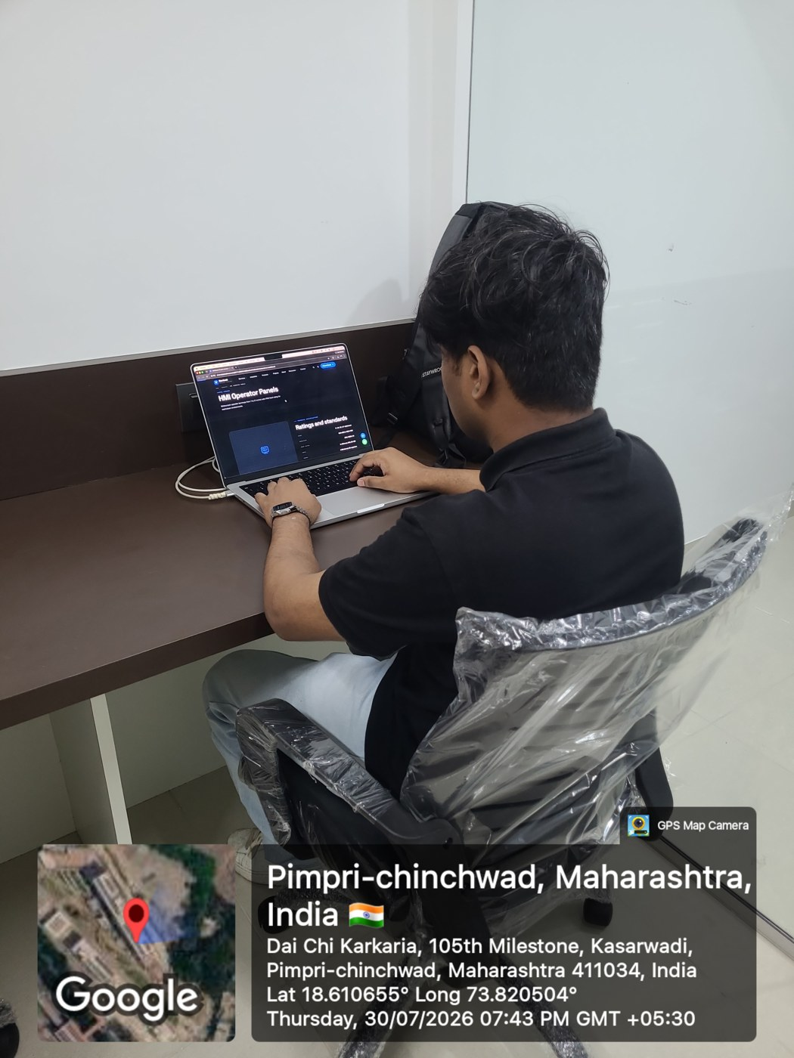

06 · ON-FIELD DOCUMENTATION
Geo-tagged Field Photographs
Internship site — Kasarwadi, Pimpri-Chinchwad, Pune 411034 · 30 July 2026
At the internship premises
Building the corporate website
Development workstation
B 914, 447/70 Nashik Phata Rd, Shastri Nagar · 18.6059° N, 73.8230° E · 07:31 PM
HMI operator panel page under development · 18.6107° N, 73.8205° E · 07:43 PM
Editor and build environment at the internship desk · 18.6107° N, 73.8205° E · 07:44 PM
31/07/2026
19
Notes:
Geo-tagged photographs captured on site at the StartBrett office in Kasarwadi, documenting attendance and the work carried out on the corporate website.

Slide 20

07 · CONCLUSIONS
Learning Outcomes
What the internship added beyond the deliverables
Technical
Analytical
Professional
Front-end engineering with HTML5, CSS3 and JavaScript
Framing an industrial problem as a prediction task
Requirement discussion with a mentor and team
Responsive and cross-browser design practice
Data cleaning, feature selection and windowing
Documentation and reporting discipline
Python data-science stack in a real workflow
Model evaluation with an objective metric
Meeting deadlines across parallel projects
Version control and structured debugging
Reading and reproducing a research paper
Workplace ethics, ownership and confidentiality
31/07/2026
20
Notes:
Beyond the two deliverables, the internship built technical, analytical and professional capability.

Slide 21
07 · CONCLUSIONS
Conclusions
01
Both deliverables met their objectives
A responsive, SEO-ready corporate website was deployed for StartBrett Private Limited, and an interpretable forecasting model was implemented and validated.
02
Simple models can beat complex baselines
Polynomial regression with ambient temperature reduced overall RMSE to 2.87% against a 17.88% baseline, without sacrificing explainability.
03
Theory became practice
The internship connected coursework in web technologies, data structures and machine learning to a real industrial workflow, from requirement to deployment.
Future work: incorporate larger datasets, richer weather features and tariff-based cost modelling to quantify the monetary benefit of improved forecasts.
21
Notes:
To conclude: both projects met their objectives, a simple interpretable model outperformed the industry baseline, and academic theory was successfully applied in practice.

Slide 22
08 · REFERENCES
References
Research papers and sources consulted during the internship
[1]
Kamoona, A., Song, H., Keshavarzian, K., Levy, K., Jalili, M., Wilkinson, R., Yu, X., McGrath, B. & Meegahapola, L. (2023). Machine learning based energy demand prediction. Energy Reports, 9, 171–176.
[2]
Suganthi, L. & Samuel, A. A. (2012). Energy models for demand forecasting — a review. Renewable and Sustainable Energy Reviews, 16(2), 1223–1240.
[3]
Mahia, F., Dey, A. R., Masud, M. A. & Mahmud, M. S. (2019). Forecasting electricity consumption using ARIMA model. IEEE International Conference on Sustainable Technologies for Industry 4.0.
[4]
Zhang, Y., Chen, W., Xu, R. & Black, J. (2016). A cluster-based method for calculating baselines for residential loads. IEEE Transactions on Smart Grid, 7(5), 2368–2377.
[5]
Xia, M., Shao, H., Ma, X. & de Silva, C. W. (2021). A stacked GRU-RNN-based approach for predicting renewable energy and electricity load for smart grid operation. IEEE Transactions on Industrial Informatics, 17(10), 7050–7059.
[6]
Krishnadas, G. & Kiprakis, A. (2020). A machine learning pipeline for demand response capacity scheduling. Energies, 13(7).
31/07/2026
22
Notes:
These are the primary sources; the reference paper by Kamoona et al. provided the framework reproduced in this internship.

Slide 23

Thank You
Questions and feedback are welcome.
Pranav Ashok Pande
PRN 20240802208 · B.Tech. CSE (AI–ML)
D Y Patil International University, Akurdi, Pune
Internship at StartBrett Private Limited · Academic Year 2025–26
31/07/2026
23
Notes:
Thank you — happy to take questions on either the website or the forecasting model.

